Slide 1
EMPLOYEES: BE EMPOWERED
START TALKING!
about safe & responsible medication practices
Notes:
SPEAKING POINTS
No doubt you’ve been hearing and reading things in the media about our nation’s prescription painkiller epidemic. You might even know someone who has developed a problem with those types of drugs. Most of us do.
But I’d like to challenge you to take a look at your relationship with ALL prescription medications -- not just the ones that cause addiction and even death.
How to use this presentation
These PowerPoint slides and accompanying speaking points are intended to be used by employers to facilitate a 15-20 minute awareness session for employees about safe and responsible prescription medication practices.
The slides can be projected on a wall or distributed as a handout.
For additional awareness tools that can be used to supplement this presentation (e.g., fact sheets, wallet cards, posters, table tents, postcards), visit www.GenerationRxWorkplace.com/downloads.html.
For more information on how you can “Start Talking!” to your employees about alcohol and other drug issues, register to receive bi-monthly BIZ tips by visiting www.StartTalking.ohio.gov/Businesses.aspx.

Slide 2
We take a lot of meds!
70% take at least one
50% take at least 2
20% take 5 or more
Notes:
We as a nation take a lot of prescription meds.
Almost 70% of Americans take at least one prescription medication and more than half take at least two.
20% of us … take 5 or more.
And the most commonly prescribed drugs are antibiotics, antidepressants, and painkillers, like Vicodin and OxyContin.

Slide 3
Many are Abused
Second only to marijuana
Higher than all other drugs of abuse COMBINED
Classified as an epidemic
Notes:
Many of us are healthy and responsible consumers of prescription medications and enjoy a better quality of life due to the positive effect those meds have on our overall health.
However, according to several national surveys, prescription medications are being abused at a rate second only to marijuana.
In fact, we are abusing prescription drugs at a rate higher than all other drugs of abuse COMBINED … including cocaine, heroin, and methamphetamine.
And because of this high rate of abuse, the Center for Disease Control and Prevention (CDC) has classified prescription drug abuse as an epidemic.

Slide 4
Take an active role!
Talk to your doctor
Talk to your pharmacist
Use as directed
Avoid sharing (on purpose or unintentionally)
Dispose of medications properly
Notes:
Employees are being asked to take a more active role in our health and our health care spending. With the introduction of such things as high deductible insurance plans; health spending and savings accounts; and a new emphasis on prevention and wellness, the days of walking into a doctor’s office and simply following orders -- without asking critical questions -- are over.
Not only does this consumer mentality make sense from a dollars and cents standpoint, but it’s also compatible with the goal of taking ownership for our overall health and well-being.
Adopting these 5 points will arm you in becoming a safe & critical consumer of prescription medications:
Talk to your doctor
Talk to your pharmacist
Use as directed
Avoid sharing (on purpose or unintentionally), and
Dispose of medications properly

Slide 5
1. TALK TO YOUR DOCTOR
Right & responsibility
BEFORE prescribed a drug
Prepare questions
Questions about symptoms
Questions about the drug
Questions about taking the drug
Notes:
Talk to Your Doctor
You have a right and a responsibility to talk with your doctor and ask questions about your health care -- especially as it relates to prescription medications.
In fact, to be a safe and critical consumer, the time to start asking questions is before your doctor puts pen to the prescription pad.
Enlisting your doctor’s expertise at the point when you have questions and concerns about your health and discussing alternative ways to deal with the condition can help prevent substance abuse.
Time is limited during your doctor’s appointment and asking good questions takes some forethought. So it’s a good idea to prepare your questions ahead of time and literally carry your list into the office.
Consider questions in these 3 categories:
Questions about your symptoms
Questions about the drug that’s being recommended, and
Questions about taking the drug

Slide 6
Questions about Your Symptoms
Where do you think my symptoms are coming from?
Is there anything I can do to prevent this condition in the future?
What are some things – besides taking meds – that I could do to manage the symptoms?
Notes:
Ask your doctor questions about your SYMPTOMS.

Slide 7
Questions about the Drug
Can you please spell the name of the drug?
Is this the brand or generic version of the drug? Is a generic available that might cost less?
Do you have any samples of this drug to get me started?
Are there discount cards available for this drug?
What is this medication supposed to do?
What are the most important things you think I should know about this drug?
Does it have addiction potential?
Notes:
Ask your doctor questions about the DRUG that’s being recommended.

Slide 8
Questions about Taking the Drug
How might this drug interact with other things I am taking (including over-the-counter medications, supplements, herbal products or food)?
What are the possible side effects?
When do you anticipate I will experience the intended effects of the medication?
When should I take the medication?
How will I know when it’s time to stop taking the medication?
How will my progress with this drug be monitored?
How might this drug negatively impact my job?
Notes:
Ask your doctor questions about TAKING THE DRUG.

Slide 9
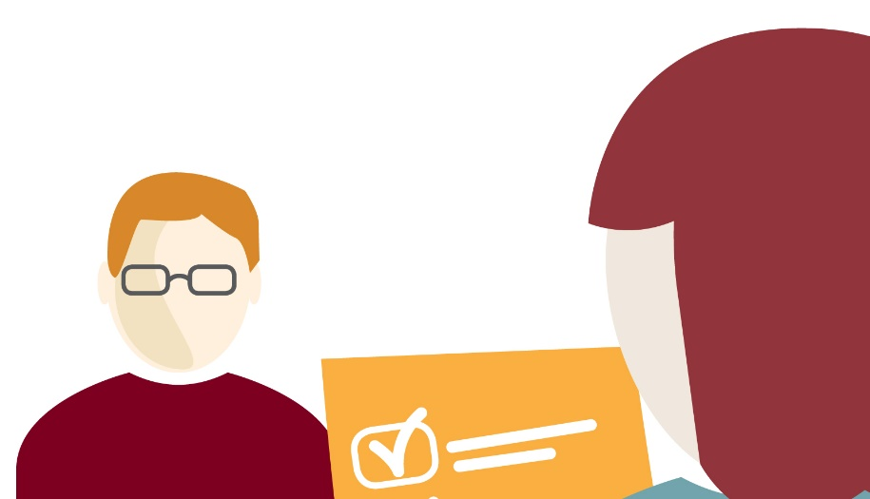
2. TALK TO YOUR PHARMACIST
Personal relationship
Most qualified to answer questions
Can help monitor
One pharmacy
Prepare questions for
before the drug is prescribed
after the drug is prescribed
Notes:
2. Talk To Your Pharmacist
Another important person on your healthcare “team” -- a person you need to talk with -- is your pharmacist.
Research suggests that if we have a personal connection with our pharmacist, we’ll be more likely to take our medications safely and appropriately. This means we’ll get the best outcomes from our medications, too.
Pharmacists are highly trained professionals and, in fact, are THE most qualified people to answer questions about medications -- including over-the-counter drugs and supplements, and their interactions with each other.
And because many of us have multiple doctors who each write prescriptions, your pharmacist can help monitor everything you are taking.
Using only one pharmacy can help you be a more safe and critical consumer of your prescription medications.

Slide 10
Ask Before the Rx is Filled
Do you have a record of my allergies?
What about a current list of other medications I am taking (including over-the-counter products)?
How much will I be charged for this medication?
Is there a generic form of this drug?
Does the pharmaceutical company offer any discount cards for this medication?
Does this medication have addiction potential?
Notes:
Ask your pharmacist questions BEFORE the Rx is filled.

Slide 11
Ask After the Rx is Filled
Do you have any concerns about this drug based on what I’m already taking?
What are the most important things you think I should know about this medication?
What’s the best time of day to take this medication?
Do I need to get up in the middle of the night to take it?
Should I take it with food or drink?
What things should I avoid while taking this medication - like exposure to the sun, alcohol, certain activities or certain foods?
What should I do if I miss a dose or take too much?
What’s the best way to store and dispose of this medication?
Is it safe to take this medication if I am or become pregnant?
Notes:
Ask your pharmacist questions AFTER the Rx is filled.

Slide 12
3. USE AS DIRECTED
Read the label
Read accompanying information
Ask before increasing or decreasing dose
Respect warnings
Alert doctor to any changes
Keep in original containers
Talk to doctor if you can’t afford the meds
Notes:
3. Use as Directed
According to a 2013 study conducted by the National Community Pharmacists Association, 75% of us who take an ongoing prescription do not take it as directed.
Be sure to:
Read the label on the bottle.
Read the information that accompanies the medications to learn even more about the drug.
Ask your doctor before increasing or decreasing your dose or stopping early.
Respect the warnings – especially as they relate to driving and other safety sensitive tasks, and consuming with alcohol or other drugs.
Alert your doctor if anything changes with your health that might warrant an adjustment to your medications – like if you are or wish to become pregnant.
Keep your medications in their original containers. (With caution, a pill box many be used to help keep track of when to take your medications.)
Talk to your doctor or your pharmacist if you can’t afford the medication.

Slide 13
4. AVOID SHARING
Class E-federal offense
Health and safety risks
labeling
allergies
other medical conditions
dosing
Notes:
4. Avoid Sharing
Sharing any type of prescription medication with another person is a class E-federal offense -- punishable by prison time and substantial fines. It’s a big deal, yet many of us are not aware of that fact when offering one of our meds to a friend or family member.
In addition to the legal consequences of sharing our medications, there are significant health and safety risks as well:
The user does not have any of the labeling or accompanying information about the medication to learn risks and precautions about taking the meds.
The user could be allergic to the medication, or could be taking something else that could cause a negative reaction.
The user might have a medical condition that would be masked or worsened by the use of a shared drug.
Dosing is an issue, as a doctor considers gender, age, weight, symptoms, and other patient information when deciding how much the patient should take.

Slide 14
Don’t share by accident!
Keep meds in secure location
Consider a place other than a bathroom
Keep out of sight and reach of children
Store in original containers
Keep close inventory of meds
Notes:
Sharing By Accident:
Over 50% of people who abuse drugs get them from a friend or family member for free.
One way to avoid medication getting into someone else’s hands is to store our meds carefully and appropriately:
Keep them in a secure location, preferably in a lock box.
Consider a place other than the bathroom. Not only is it an obvious place for abusers to look, medications can be damaged by humidity and changing temperatures in the bathroom.
Keep them out of sight and out of reach from children.
Store them in their original containers.
Keep a close inventory of your medications – especially painkillers and other drugs that are commonly abused.

Slide 15
5. DISPOSE OF MEDICATIONS APPROPRIATELY
Return unused, unneeded or expired Rx meds
Mix meds with unpalatable substance
Place mixture in sealed bag
Throw bag in household trash
Scratch-out information on Rx bottle and throw in trash
Notes:
5. Dispose of Medications Appropriately
When you are ready to pitch, the FDA has published disposal guidelines to prevent the harm associated with using an outdated or unneeded medication, or from someone else abusing the medication. These guidelines were also developed to minimize the environmental risks of introducing the medications into our waste water system by flushing:
Return unused, unneeded or expired prescription drugs to the pharmacy or a designated take-back location.
Mix medicines with an unpalatable substance such as kitty litter or used coffee grounds.
Place the mixture in a container such as a sealed plastic bag.
Throw the container in your household trash.
To dispose of your empty prescription bottles or containers, scratch out all information on the empty prescription bottle or container and throw it in your household trash, too.
You should only flush medications down the toilet if the patient information specifically says it is safe.

Slide 16
Know someone with a problem?
Help is available
Contact a professional
Check out resources available
For more information about helping resources, visit www.GenerationRxWorkplace.com
Notes:
If you know someone who might have a problem, it’s tough. But help is out there for the abuser or addict and for those of you who care about one.
In an ideal world, a person who has a problem with drugs would simply acknowledge and take care of it, without it ever impacting their family or job. But because of the nature of abuse and addiction, and the stigma and denial attached to the issue, that rarely happens.
So step #1 if you think you have or could be developing a problem, or care about someone who is struggling, is to contact a professional who can help. It’s too hard to “go it alone.”
Check out what resources might be available through your employer or in your community.
And for more information about helping resources, visit www.GenerationRxWorkplace.com.

Slide 17
The abuse of prescription medications is 100% preventable!
Notes:
Remember … the abuse of prescription medications is 100% preventable if we learn to be safe and critical consumers of these powerful substances.

